Slide 1
Project: Plastics Data Source: Plastic pollution Category: Agriculture & Climate
Group 1
members:
1.Maureen wachinga Gichuki
2. James mwangi
3. Lucy njeri sophia

Slide 2
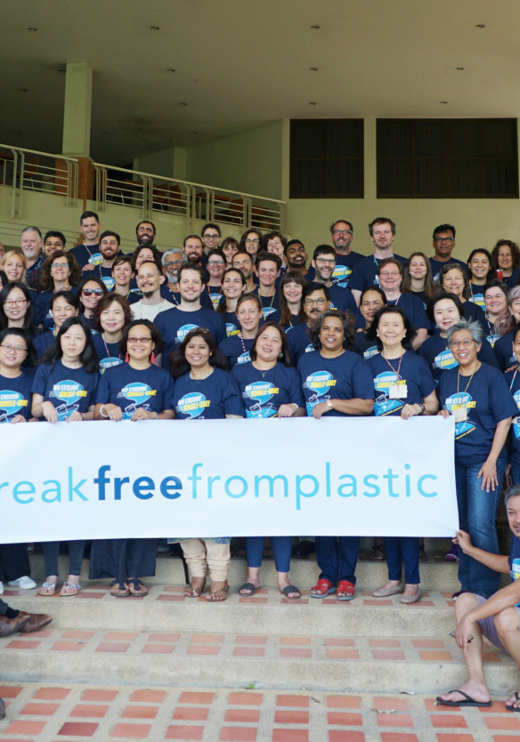
PLASTIC POLLUTION
Plastic pollution is a significant environmental issue resulting from the accumulation of plastic products in the environment.
Sources of pollution.
Plastic pollution mainly comes from single-use plastics, such as bags, bottles, straws, and packaging materials. Industrial activities and improper waste management also contribute.

Slide 3
Impact on Wildlife:
Animals can ingest plastic or become entangled in it, leading to injury or death. Microplastics can enter the food chain, affecting a wide range of species.
Environmental Effects:
Plastics can take hundreds of years to decompose, leading to long-term environmental damage. They can release toxic substances into the soil and water.
Human Health:
Microplastics have been found in drinking water and food, raising concerns about potential health impacts on humans.

Slide 4
Definition of terms.
hdpe | High density polyethylene count (Plastic milk containers, plastic bags, bottle caps, trash cans, oil cans, plastic lumber, toolboxes, supplement containers)
ldpe | Low density polyethylene count (Plastic bags, Ziploc bags, buckets, squeeze bottles, plastic tubes, chopping boards)
o | Category marked other count
pet | Polyester plastic count (Polyester fibers, soft drink bottles, food containers (also see plastic bottles)
pp | Polypropylene count (Flower pots, bumpers, car interior trim, industrial fibers, carry-out beverage cups, microwavable food containers, DVD keep cases)
ps | Polystyrene count (Toys, video cassettes, ashtrays, trunks, beverage/food coolers, beer cups, wine and champagne cups, carry-out food containers, Styrofoam)
pvc | PVC plastic count (Window frames, bottles for chemicals, flooring, plumbing pipes)

Slide 5
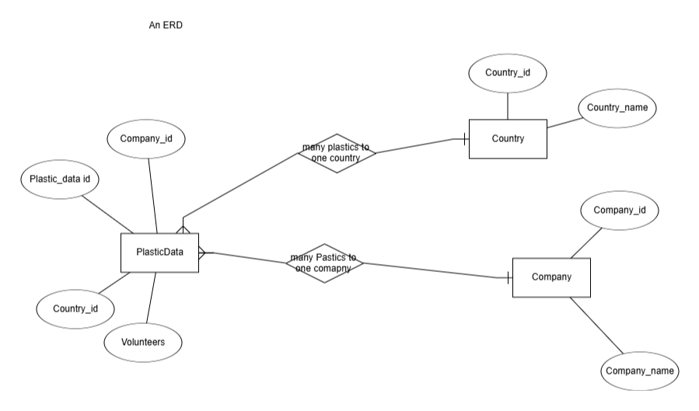
ER Diagram

Slide 6
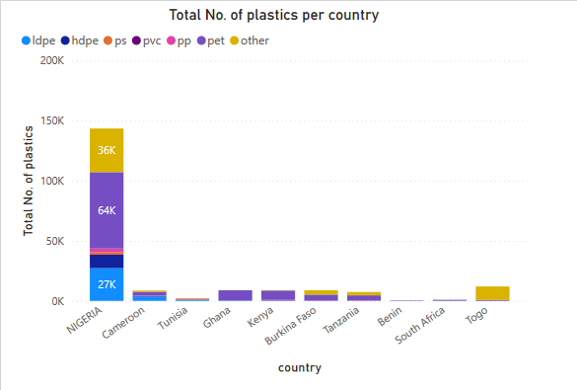

Slide 7
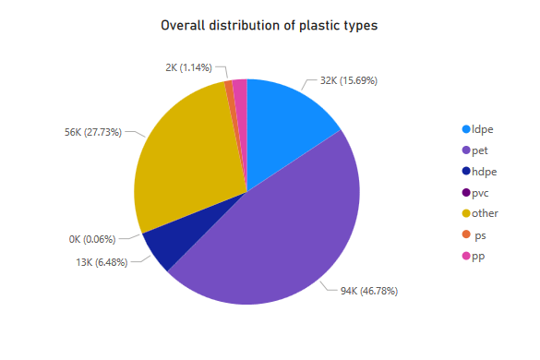

Slide 8
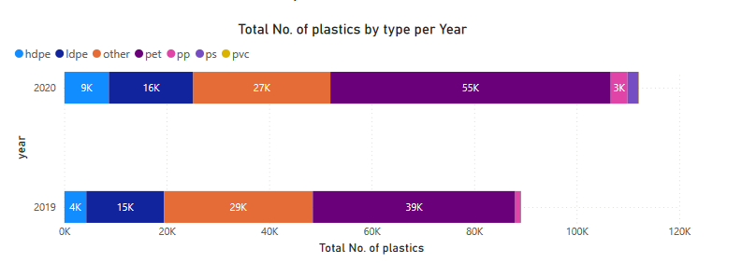

Slide 9
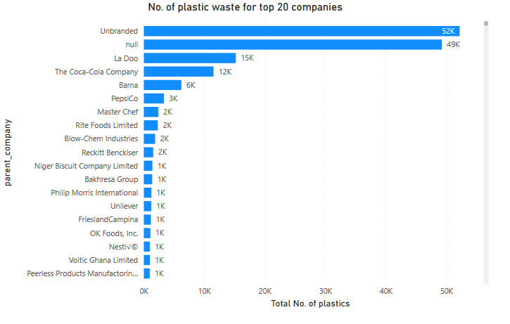

Slide 10
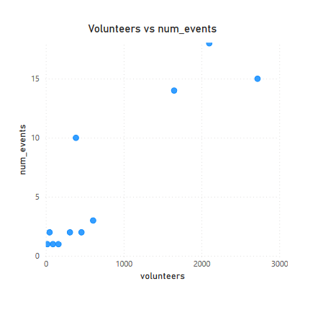

Slide 11
Solutions:
Reducing plastic pollution involves strategies like improving waste management, promoting recycling, banning single-use plastics, and encouraging alternatives such as biodegradable materials.
Awareness and Action:
Public awareness campaigns, community clean-ups, and policy changes can help combat plastic pollution on local and global scales.
Addressing this issue requires collective effort from individuals, communities, businesses, and governments.

